Slide 2
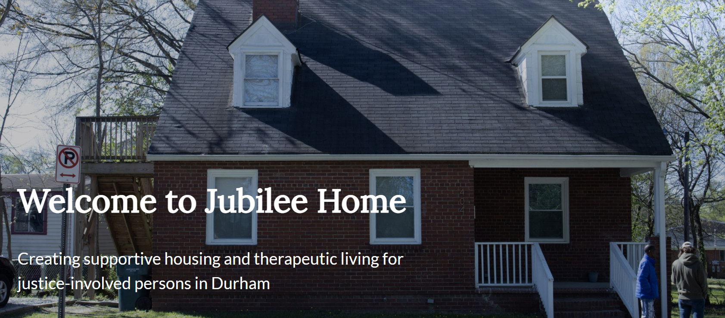

Slide 3
Who We Serve - Challenges
Past and present barriers can make it difficult to access services and stay engaged.

Slide 4
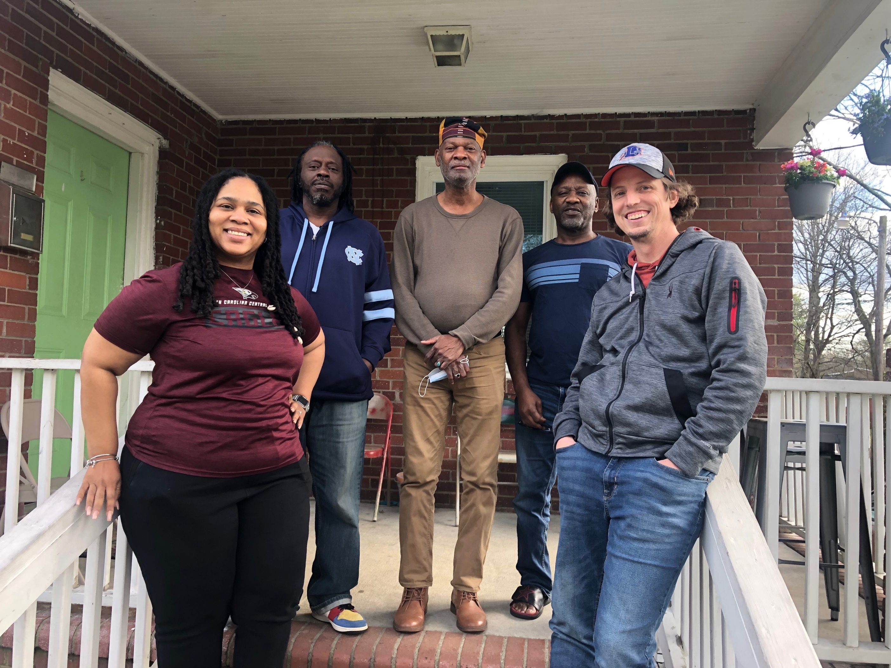
Our Staff
Left to right: Leticia Soria, Donald Baker, Hasan Salih, David Logan, and David Crispell

Slide 5
In Spring 2021, we bought the duplex across the street from Jubilee Home and renovated it creating4 units of permanently affordable low barrier housing

Slide 6
Before Jubilee Home
Residents came to us from…

Slide 7
Referral Partners
DCo jail mental health unit
Drug Court
Welcome Home
DCo Local Reentry Council
District 14 Community Corrections
Durham Recovery Response Center
Durham Outpatient
Religious Coalition for a Nonviolent Durham
Criminal Justice Resource Center
As well as community referrals and state facilities

Slide 8
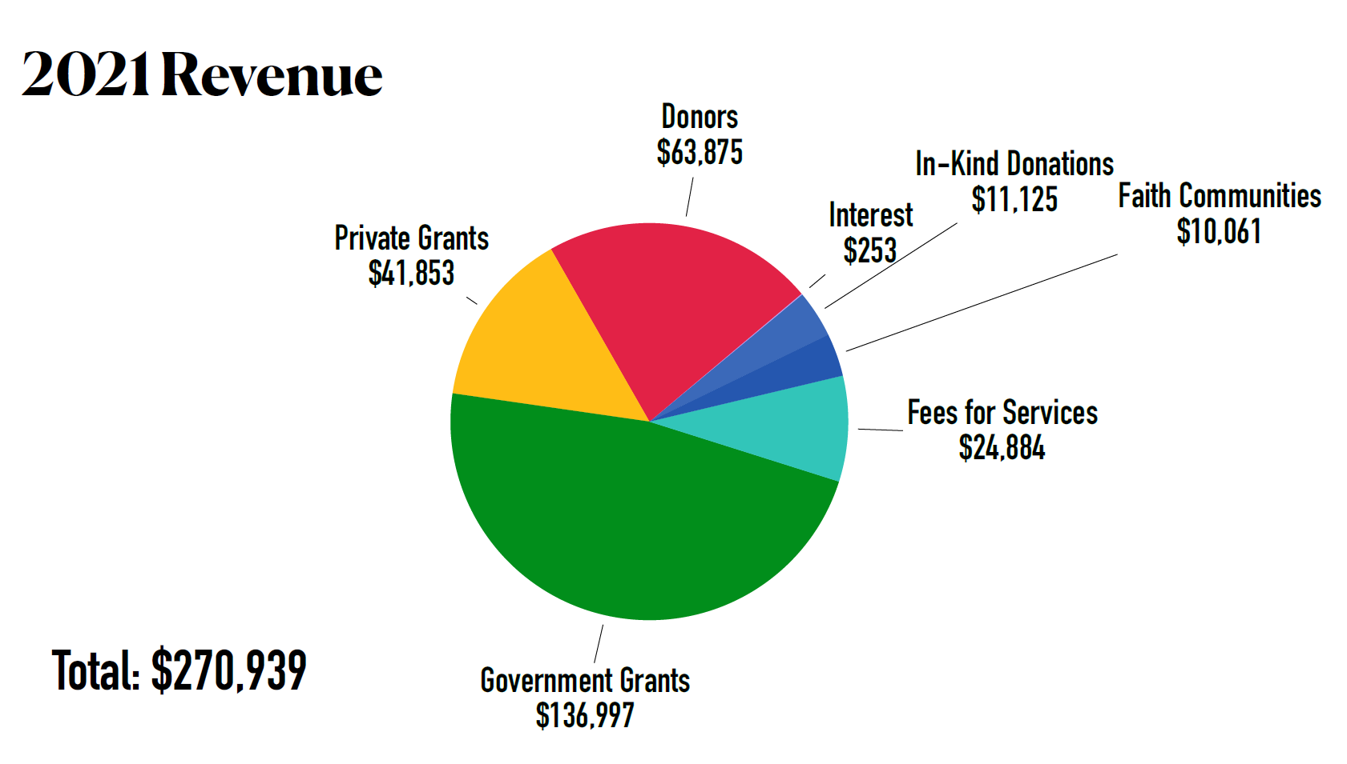

Slide 9
After Jubilee Home
Residents went to…
*Some residents fit into multiple categories

Slide 11
Physical address: 404 E Umstead St., Durham, NC 27707
Mailing address: P.O. Box 289, Durham, NC 27702
Phone: (919) 381-4431
Website: www.jubilee-home.org
Email: info@jubilee-home.org
Facebook: www.facebook.com/JubileeHomeOrg
Venmo: @JubileeHomeNC

